Slide 1

Machine Learning Logistic Regression
By K. Igwe 2021

Slide 2
Lesson Objectives
Rationale for Logistic Regression
Identify the types of variables used for dependent and independent variables in the application of logistic regression
Describe the method used to transform binary measures into the likelihood and probability measures used in logistic regression
Interpret the results of a logistic regression analysis &assessing predictive accuracy

Slide 3
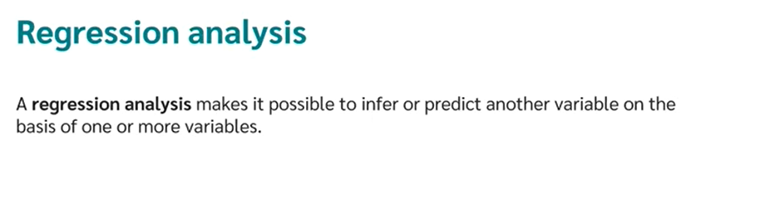
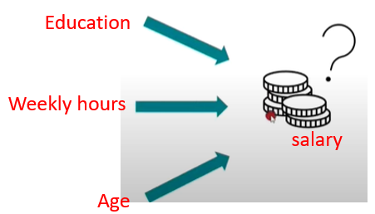
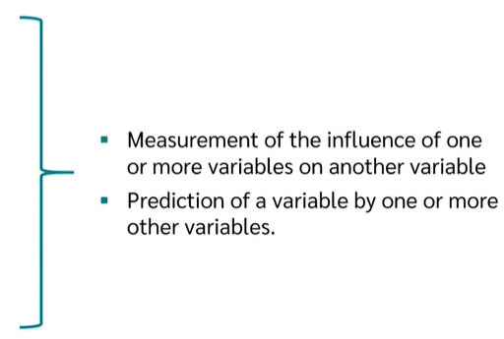
Overview of Regression Analysis
eg What influences a person ‘s salary?
Regression Analysis is used to achieve two goals
Independent
Variables [Predictors]
Dependent
Variable (Criterion)

Slide 4
Forms of regression Analysis

Slide 6
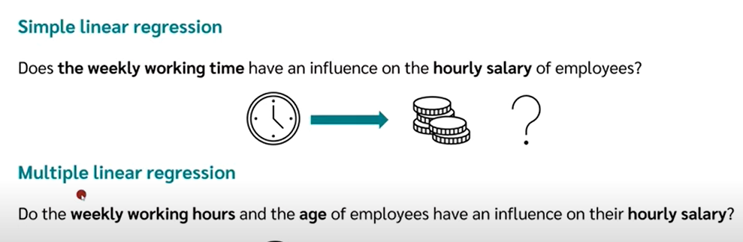

Slide 7
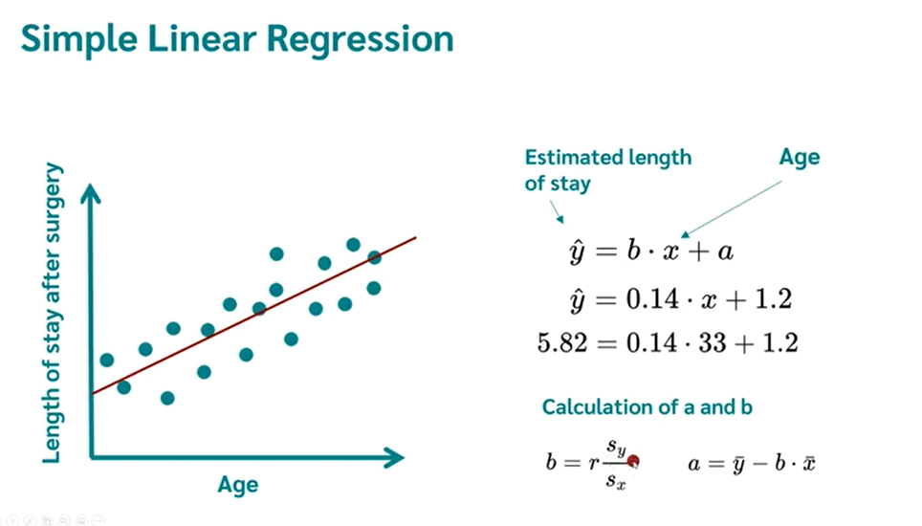

Slide 8
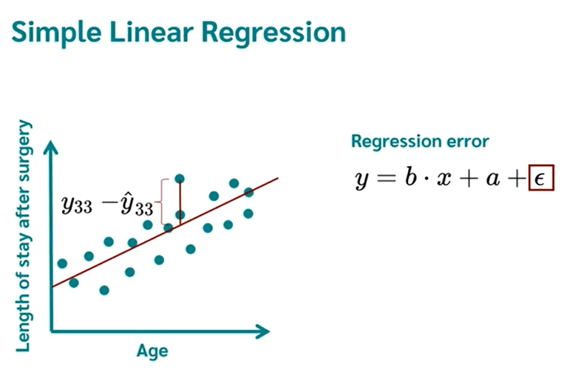

Slide 9
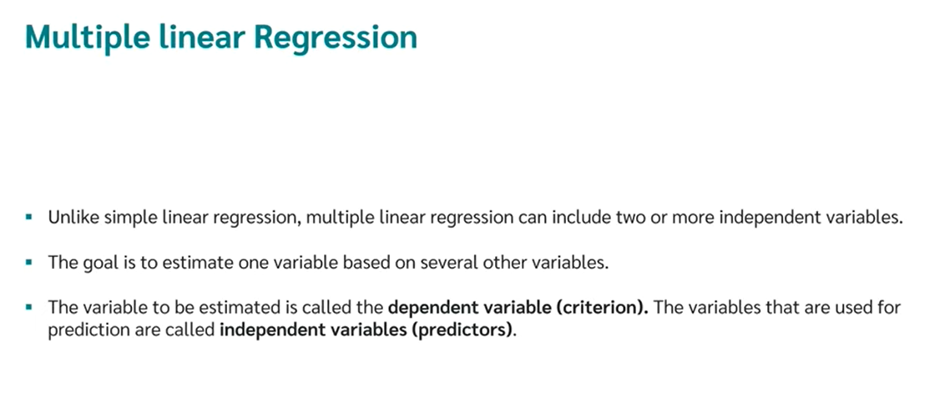

Slide 10
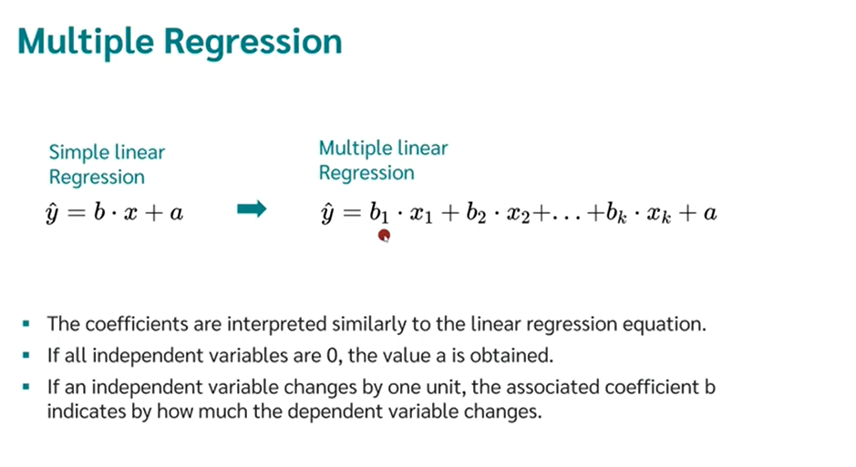

Slide 11
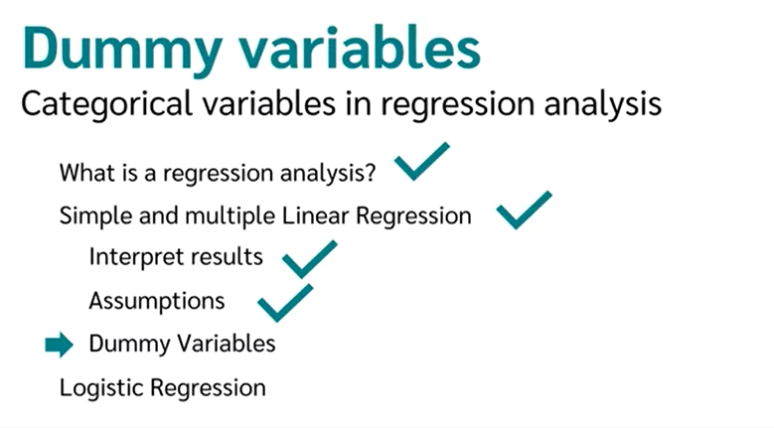
Categorical variables with more than one value

Slide 12
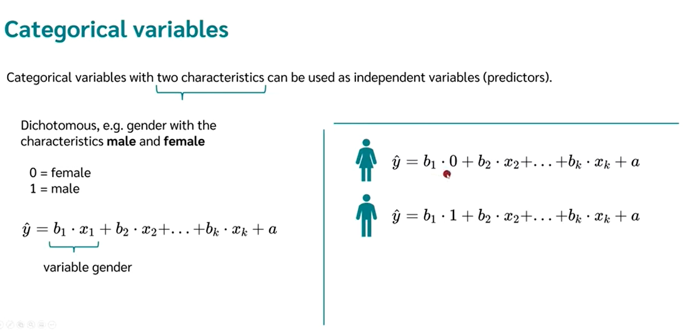

Slide 13
What is logistic regression
Classification algorithm that uses regression analysis conducted when the dependent variable (target) is categorical or binary

Slide 14
When do we use LR?
Continuous—such as temperature in degrees Celsius or weight in grams.
continuous data is categorized as either interval data by;
coding
values are equally split
Discrete, ordinal—data which can be placed into some kind of order on a scale.
A score of 1 indicates a lower degree of happiness than a score of 5,
but there is no way of determining the numerical value between each of the points on the scale.
Discrete, nominal—data which fits into named groups which do not represent any order or scale.
E.g., eye color may fit into the categories “blue”, “brown”, or “green”, but there is no hierarchy to these categories.

Slide 15
Types of logistic regression
Binary logistic regression
Number of categories are 2
Characteristics are at 2 levels
E.g. Pass or Fail
Yes or No
High or Low
Ordinal logistic regression
Number of categories are 3 or more
Characteristics are at natural ordering of the levels
E.g. Medical condition(critical, serious, stable, good), survey results (Disagree, Neutral, Agree)
Nominal logistic regression
Number of categories are 3 or more
Characteristics are not as per natural ordering of the levels
E.g. Color (red, Blue, Green), school subjects (science, Math, Art)
Poisson logistic regression
Number of categories are 3 or more.
Characteristics are the number of time an event occurs.
E.g. 0, 1, 2, 3, etc.

Slide 16
Examples of Binary classification problems
Spam Detection : Predicting if an email is Spam or not
Credit Card Fraud : Predicting if a given credit card transaction is fraud or not
Health : Predicting if a given mass of tissue is benign or malignant
Marketing : Predicting if a given user will buy an insurance product or not
Banking : Predicting if a customer will default on a loan.

Slide 17
Logistic regression assumptions
It fits into one of two clear-cut categories.
The predictor variables (or the independent variables) should be independent of each other.
Independent variables should be linearly related to the log odds.
Requires fairly large sample sizes—the larger the sample size, the more reliable (and powerful) you can expect the results of your analysis to be.

Slide 18

Goal
Goal: represent probability of success $(p)$ as a binary response variable (using simple logistic regression).

Slide 19
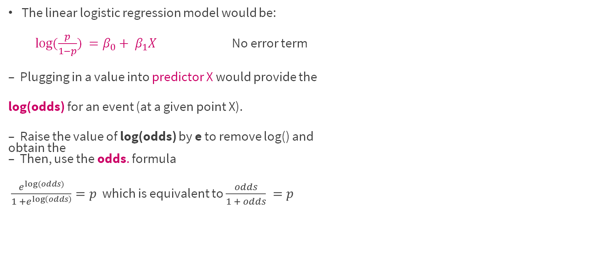
Logistic Regression Model
The linear logistic regression model would be:
$log⁡(\frac{p}{1−p}) =β_{0}+ β_{1}X$ No error term
– Plugging in a value into predictor X would provide the
log(odds) for an event (at a given point X).
– Raise the value of log(odds) by e to remove log() and obtain the – Then, use the odds. formula
$\frac{e^{log⁡(odds)}}{1 +e^{\log\left(odds\right)}}=p$ which is equivalent to $\frac{odds}{1 + odds} =p$

Slide 20
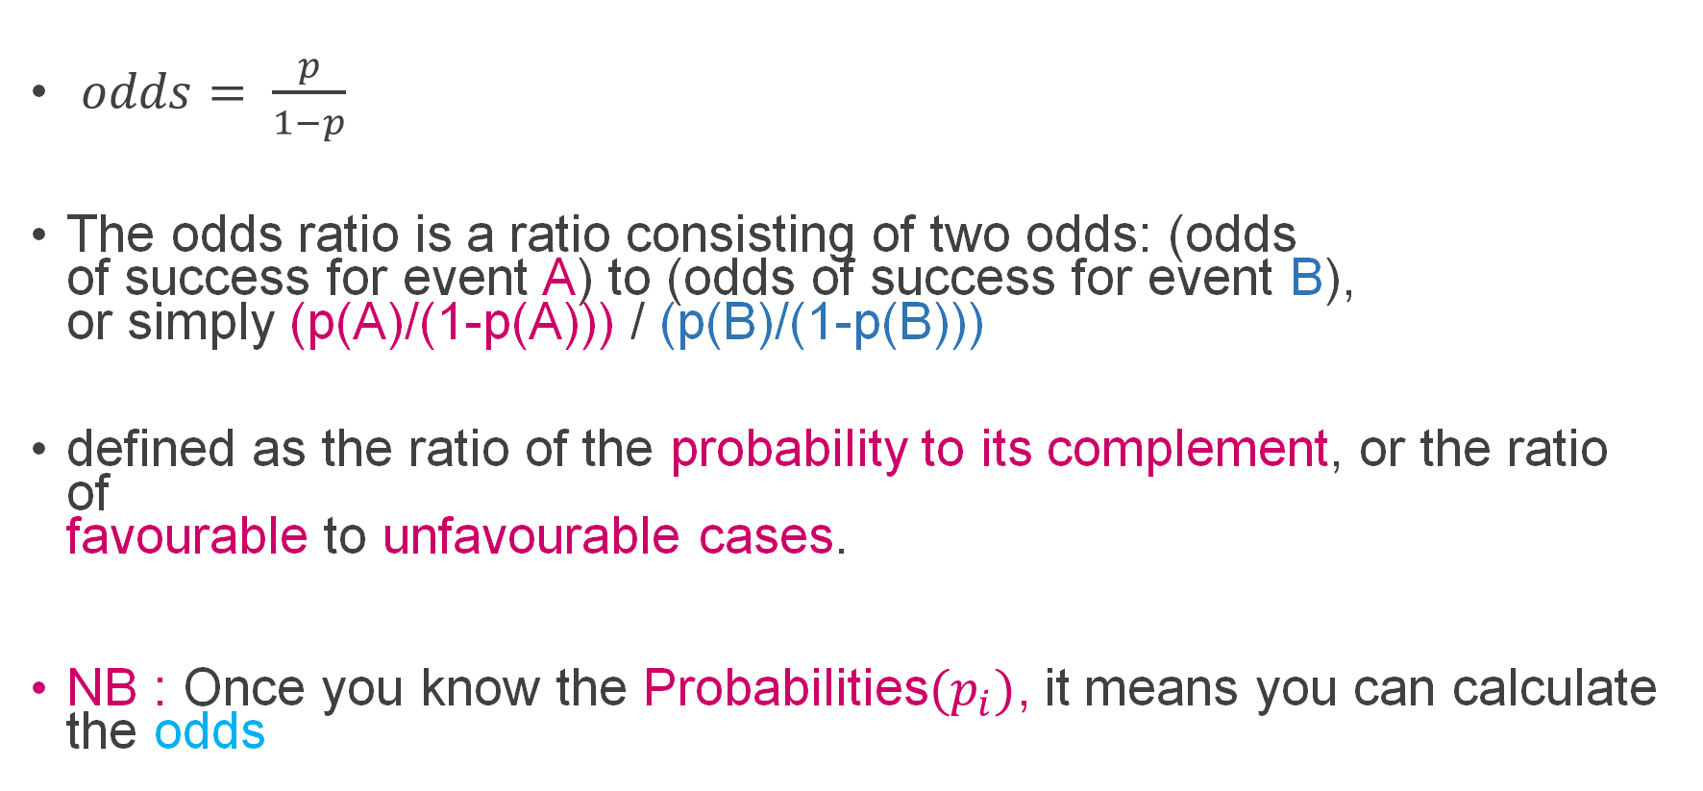
ODDS
$odds= \frac{p}{1−p}$
The odds ratio is a ratio consisting of two odds: (odds of success for event A) to (odds of success for event B), or simply (p(A)/(1-p(A))) / (p(B)/(1-p(B)))
defined as the ratio of the probability to its complement, or the ratio of favourable to unfavourable cases.
NB : Once you know the Probabilities${(p}_{i})$, it means you can calculate the odds

Slide 21

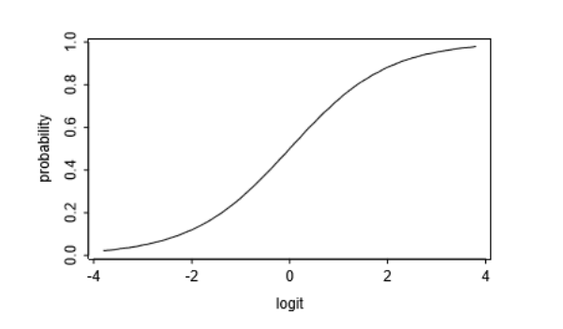
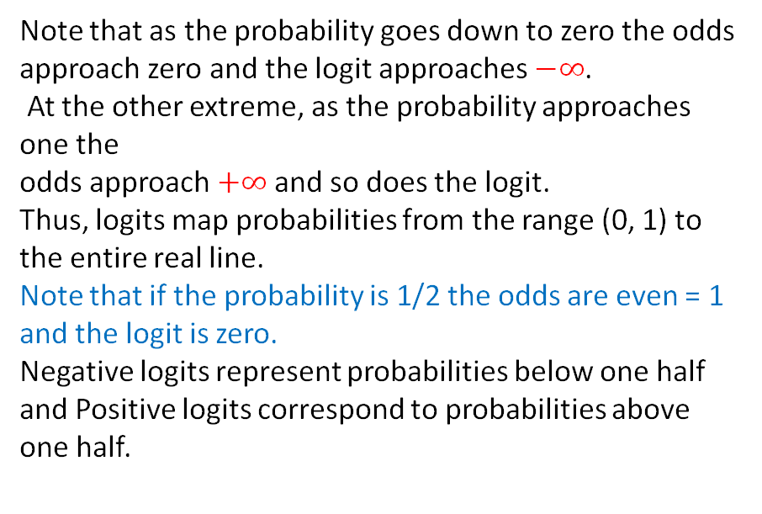
Logit or log(odds)
Note that as the probability goes down to zero the odds approach zero and the logit approaches $−∞$.
At the other extreme, as the probability approaches one the odds approach $+∞$and so does the logit.
Thus, logits map probabilities from the range (0, 1) to the entire real line.
Note that if the probability is 1/2 the odds are even = 1 and the logit is zero.
Negative logits represent probabilities below one half and Positive logits correspond to probabilities above one half.

Slide 22
Example
The Contraceptive Use Data Table below is an adapted from Little (1978), shows the distribution of 1607 currently married and fecund women interviewed in the Fiji Fertility Survey of 1975, -classified by current age, level of education, desire for more children, and contraceptive use.
In our analysis of these data we will view current use of contraception as the response or dependent variable of interest and age, education and desire for more children as predictors.
Note that the response has two categories: use and non-use.
In this example all predictors are treated as categorical variables, but the techniques to be studied can be applied more generally to both discrete factors and continuous variates.

Slide 23
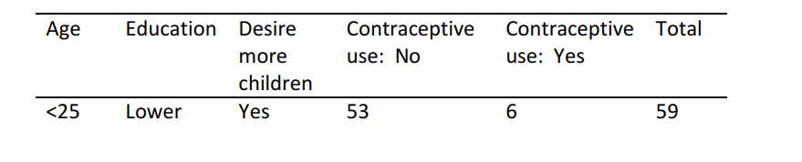
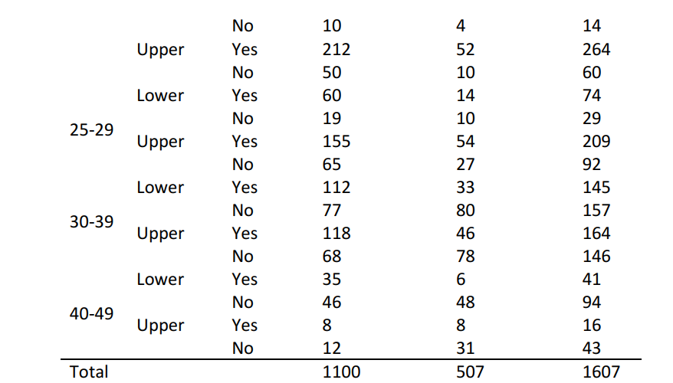
Example Cont..

Slide 24
Example Cont..
Calculate the odds and the logit or log-odds of the contraceptive use?

Slide 25
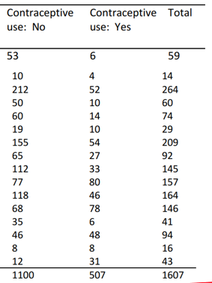

Solution
Total(Yes) = 507
Total(No) = 1100
Grand Total = 1607
$p_{yes}=\frac{507}{1607}$ $p_{no}=\frac{1100}{1607}$

Slide 26

Odds and logit
$ODDS =\frac{p_{yes}}{p_{no}}$ $=\frac{\left(\frac{507}{1607}\right)}{\left(1− \frac{507}{1607} \right)}$
$=\frac{\left(\frac{507}{1607}\right)}{\left(\frac{1100}{1607} \right)}$
$=\frac{507}{1100}$ $≈ 0.4609$
$\log\left(ODDS\right)=\ln\left(\frac{507}{1100}\right)$ $≈ −0.7746$

Slide 27
Exs
The data below is extracted from the Belgium Campus University on Zoom use.
Using the below data, Calculate the odds and the logit of odds for Zoom use.
Age | Year of Study | Laptop | Zoom use: No | Zoom use: Yes
<20 | First Year | Yes No | 55 14 | 11 8
 | Third Year
20-25 | First Year | Yes No | 52 252 | 63 12
 | Third Year
25-39 | First Year | Yes No | 44 85 | 37 44
 | Third Year

Slide 28
ODDS and ODDs Ratio from different groups.
Example:
100 participants are randomized to a new or standard treatment (50 subjects to each treatment group)
Groups | New | Standard | Total
Success | 20 | 10 | 30
Failure | 30 | 40 | 70
TOTAL | 50 | 50 | 100

Slide 29
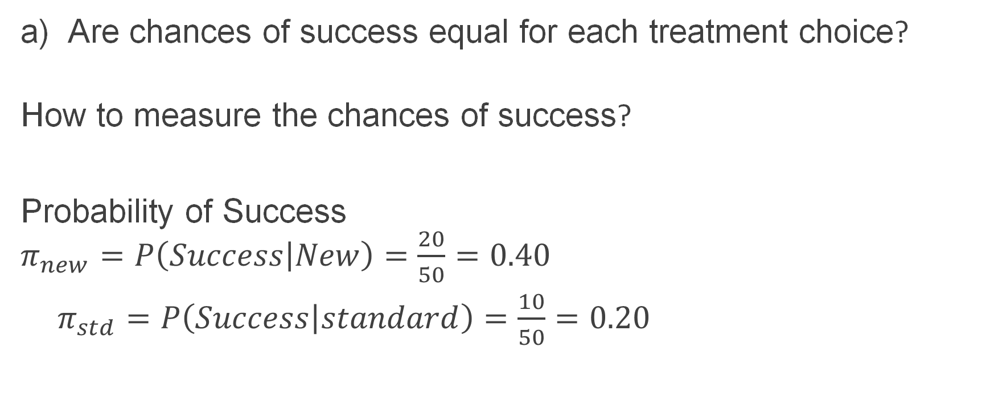
Qns
Are chances of success equal for each treatment choice?
How to measure the chances of success?
Probability of Success $π_{new}=P\left(Success | New\right)=\frac{20}{50}=0.40$
$π_{std}=P\left(Success | standard\right)=\frac{10}{50}=0.20$

Slide 30


The odds of success:
${ODD}_{new}=\frac{π_{new}}{1−π_{new}}$
= $\frac{\frac{20}{50}}{1−\frac{20}{50}}$
=$\frac{20}{30}$ = 0.6667
$${ODD}_{std}=\frac{π_{std}}{1−π_{std}}$$
= $\frac{\frac{10}{50}}{1−\frac{10}{50}}$
=$\frac{10}{40}$ = 0.25

Slide 31
Odds Ratio (OR) Relative ODDS
is a possible way to capture inequality in the chances of success:
Obviously the odds ratio is just a RATIO OF ODDS
If OR =1 then the success chances are the same in each group.
What is the OR of the new treatment comparing to the standard one?

Slide 32

Sln
$OR=\frac{{ODD}_{new}}{{ODD}_{std}}$
= $\frac{0.6667}{0.25}$
=2.6668

Slide 33
Exs
The data below is extracted from the Belgium Campus University on Pass Rate.
Using the below data, The purpose of the study was to obtain estimates of the pass and fail rate cases and to explore its risk factors.
Regular Zoom Users | Laptop | Pass | Fail
Yes | Yes | 68 20 | 12 9
No
Yes | No | 115 49 | 55 10
No

Slide 34
Questions
Calculate the odds in favour of a Non-Laptop holder that is a regular Zoom user.
Calculate the odds in favour of a Laptop Holder that is a regular Zoom user.
Calculate the relative odds (odds ratio), compared to Laptop Holders that a Non-Laptop Holder is a regular Zoom user.
Amongst the persons who Passed, calculate the relative odds (odds ratio), compared to Laptop Holder that a Non-Laptop holder is a regular Zoom user.

Slide 35

a) Calculate the odds in favour of a Non-Laptop holder that is a regular Zoom user.
 | Laptop Status
Zoom Regular User | Yes | No
Yes No | 80 29 | 170 59 | 250 88
Totals | 109 | 229 | 338
$${ODD}_{Non−Laptop}=\frac{\frac{170}{229}}{1−\frac{170}{229}}$$
= $\frac{\frac{170}{229}}{\frac{59}{229}}$
= $\frac{170}{59}$ = 2.881

Slide 36

b) Calculate the odds in favour of a Laptop holder that is a regular Zoom user.
 | Laptop Status
Zoom Regular User | Yes | No
Yes No | 80 29 | 170 59 | 250 88
Totals | 109 | 229 | 338
${ODD}_{Laptop−Holder}=\frac{\frac{80}{109}}{1−\frac{80}{109}}$
= $\frac{\frac{80}{109}}{\frac{29}{109}}$
= $\frac{80}{29}$ = 2.7586

Slide 37

c) Calculate the relative odds (odds ratio), compared to Laptop Holders that a Non-Laptop Holder is a regular Zoom user.
${ODD Ratio}_{Non−Laptop Compared to Laptop Holders}=\frac{2.881}{2.7586}$
= 1.044

